Slide 1

Processing Advancements Within Reach for Achieving Significant Reductions in Carbon Fiber Cost of Manufacturing
JEC Europe 2013, Paris
ICS Carbon Conference

Slide 2

Agenda
Introductions
Historic Advancements of Scale & Integration
A Different Approach: Rethinking Unit Operations
    Reducing Environmental Losses
    Reducing Purge Barriers
    Reconfiguration
  Achievable Targets for the Future

Slide 3
Introduction: About Harper

Slide 4
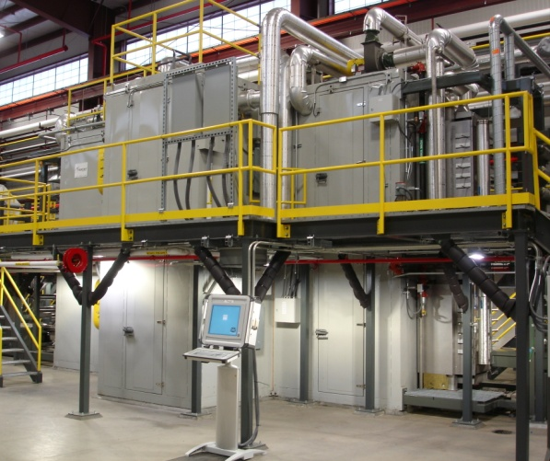
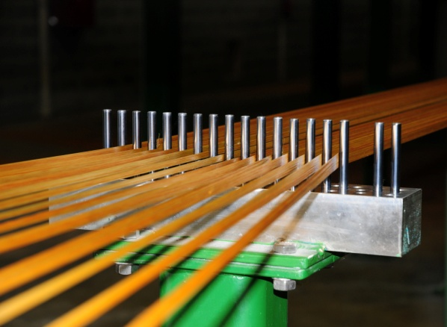
About Harper
Core Skills:
Scale up of New or Challenging Processes
    200°C – 3000°C
    Atmospherically Controlled
    Continuous Processing
Construction Techniques in
Metallic > Ceramic > Graphitic
Integrated Systems Design – Plant Supply
Complex Flows of Advanced Materials
Precise Control of Gas - Solid Interactions

Slide 5
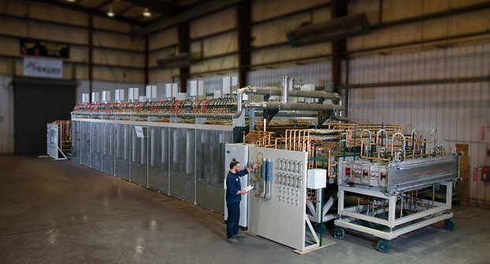
Advanced Thermal Systems for Fiber Processing
About Harper
PAN based C-fiber
Pitch based C-fiber
Rayon based C-fiber
Alternative Precursor Development
Carbon Nano Tubes / Fibers
Carbon Fiber Recycling
A Broad Experience Base in a Range of Carbon Processes
4
Notes:
4

Slide 6
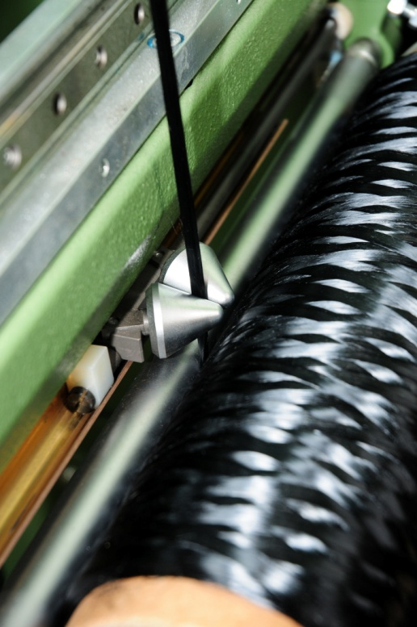
Services to the Carbon Fiber Market
About Harper
Equipment Supply (~40 Years)
  LT Furnaces, HT Furnaces and UHT Furnaces
  Atmospherically Controlled Oxidation Ovens
  Surface Treatment & Drying
  Material Mass Transport & Waste Gas Treatment
Complete System Supply (~15 Years; >10 contracts)
  Systems Integration and Energy Recovery
Feasibility Studies & Modeling
Retrofits, Revamps & Upgrades
Business Development & Consulting
Training & Optimizations
5
Notes:
5

Slide 7
Historic Advancements
of Scale and Integration

Slide 8
Diminishing Returns on Economies of Scale:
Carbon Fiber Conversion Process
SPUN
FIBER
CREEL
PRE-TREAT
OVENS
LT
FURNACE
HT
FURNACE
SURF.
TREAT
WINDING
WASTE
GAS
ABATEMENT
Complexity and Cost added through Waste Gas Treatment
Significant Opportunity for Energy Recovery and Cost Reduction; through further Flowsheet sophistication
2

Slide 9
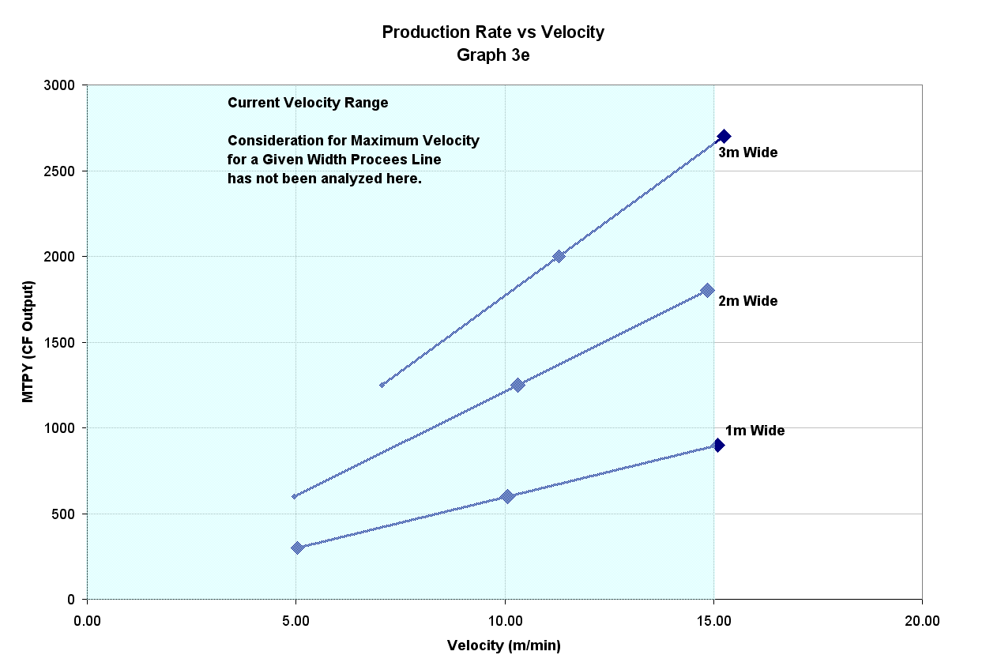
State of the Industry:
Review of Scales of Operations
2012
2009
Capacity Expansion 2011 - 2012 Based on Faster Line Velocities; Higher Production Rates from 3m Single Muffle

Slide 10
State of the Industry:
Review of Scales of Operations
Modern Line Speeds
  At 10m/min – 20 m/min for a state of the art line
Oxidation Oven Capacities
  More Than 500 – 800 kg/hr feed of PAN
  More than 500 m – 1000m Overall Heated Length
  4 Zones Minimum; Typically 6 – 8 Zones
  3m wide designs are the prevalent state of the art design
  Unsupported Heated Lengths typically less than 15m
LT and HT Furnaces Understand Your Process and the Impact of Technical Specifications
  3m wide designs wide are prevalent state of the art design
  Unsupported Heated Lengths 15 m – 20m
  HT Temperatures Regimes <1450C, 1600C, and 1800C or greater

Slide 11
Economies of Scale
Cost Dynamics as a Function of Scale-Up

Slide 12
Cost Structure Per Unit Operations
Total Conversion Process Cost: ~45 MM USD
Capital Depreciation of $2.14 USD / kg (with 7 yrs S.L.D.)
Exclusive of Facility, Utilities, Installation

Slide 13

Challenges to Growth
in Carbon Fiber Operations
Diminishing Returns on Economies of Scale
The Carbon Fiber Footprint
Investment in Technology Advancements
Supply Chain Risks
Optimizing the Project Development Timeline

Slide 14
Asymptote
Indicative of
Diminishing
Returns
Diminishing Returns on Economies of Scale
Cost Dynamics as a Function of Scale-Up

Slide 15






CO2 Emissions Variation
by Scale and Integration
Within a Given
Production Rate,
larger CO2 footprint
comes from Smaller
Line Sizes and Less
Sophisticated Off Gas
Treatment
Sample Data from harperbeacon.com

Slide 16
Challenges to Capturing Growth:
The Carbon Fiber Footprint
CO2
Emissions
Modeling
Primary Results from Sample Evaluation:
Production Rates: 500 – 2250 TPY
Line Sizes: 1750 & 3000 mm Wide
CO2 Emissions*: 23.4 – 9.7 kg CO2 Per kg CF
Theoretical CO2*: 2.7 (average) kg CO2 Per kg CF
(*Energy to Produce Purge Gas Ignored)
CAPEX $2.17 – $4.55 USD / kg of CF
OPEX $6.27 – $14.58 USD Per kg CF
A CO2 Foot Print that is 3x – 9x the theoretical value leaves much room for improvement and optimization.
The practical consequence of a lower CO2 footprint will be reduced operating costs (per kg of CF)
Sample Data from harperbeacon.com

Slide 17
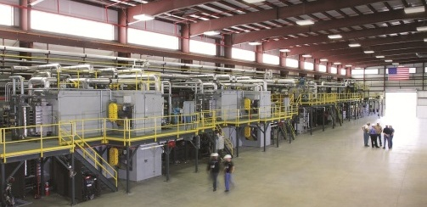
State of the Art - Dynamics
Larger capital expense for larger capacity lines
But, Higher Capacity Lines achieve lower energy requirements (lower OPEX). Production requires less kilowatts per kg/hr of produced carbon fiber
(Of Course)
  Large Capital Investment is Offset by Lower Operating Cost Over Payback over time, 3 year – 7 year Return On Investment (ROI).
Courtesy Of: Oak Ridge National Laboratory Carbon Fiber Technology Center

Slide 18
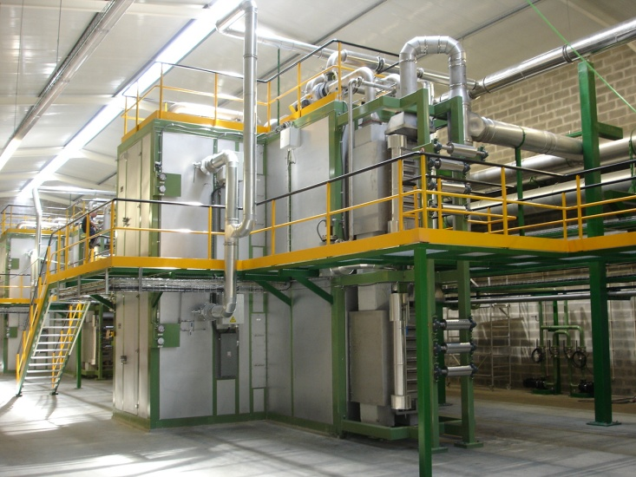
Oxidation Oven Power Requirements
Oxidation Oven Heat Balance is driven by:
  Exhaust Losses – Hot Air Leaving the Oven at Temperature, Replaced by Cold Air Flowing Into Oven Zone
  Mechanical Energy (Mixing of Atmosphere, Fans)
  End Losses (Heater Flowing Out of Furnace with Material Cooling at Turnaround Rolls) Air Seal Losses
  Wall Losses – Heat Flowing Through the Insulated Walls

Slide 19
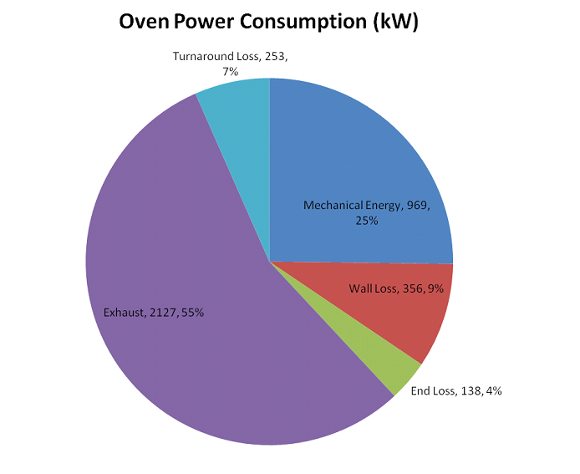
Oxidation Oven Power Utilization
Assumptions:
1500 TPY Production
12k Carbon Fiber
6mm Spacing Per Tow
90 Minutes Retention in Ovens
Oven Operating with Minimum to Moderate Heat Recovery from Waste Gas

Slide 20
Oxidation Oven Power by Scale

Slide 21
LT & HT Furnace Power Requirements
Furnace Heat Balances are driven by:
  Material Load (Heating of Fiber and Zone by Zone to Temperature – Much Greater Than Just the Sensible Heat of Carbon Fiber)
  Energy Being Carried Out: by Exhaust Vent, by Vent Conduction, by Purging of Shell and by Purging of Process Atmosphere
  End Losses, Energy Flowing Out of Entrance and Exit End, Radiation from Ends. Sight Port Losses.
  Wall Losses – Heat Flowing Through the Insulated Walls
  Conduction of Energy through Muffle and Elements
  Cooling Water Losses

Slide 22
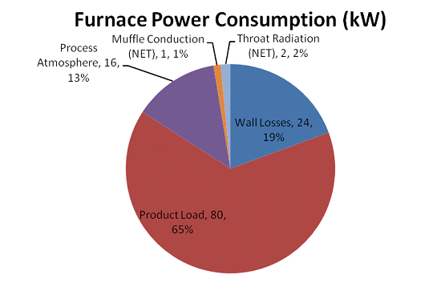
LT Furnace Power Utilization
Assumptions:
1500 TPY Production
12k Carbon Fiber
6mm Spacing Per Tow
90 Seconds Retention in LT

Slide 23
LT Furnace Power by Scale

Slide 24
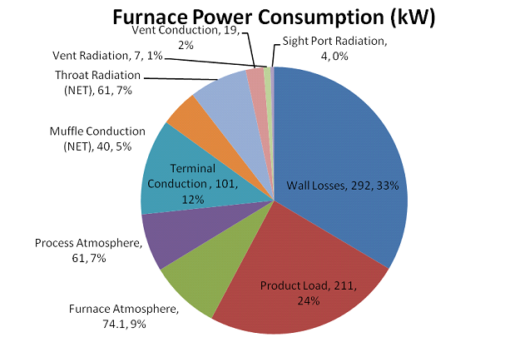
HT Furnace Power Utilization
Assumptions:
1500 TPY Production
12k Carbon Fiber
6mm Spacing Per Tow
90 Seconds Retention in HT
1800C Design of r HT

Slide 25
HT Furnace Power by Scale

Slide 26
Different Approach:
Rethinking Unit Operations

Slide 27
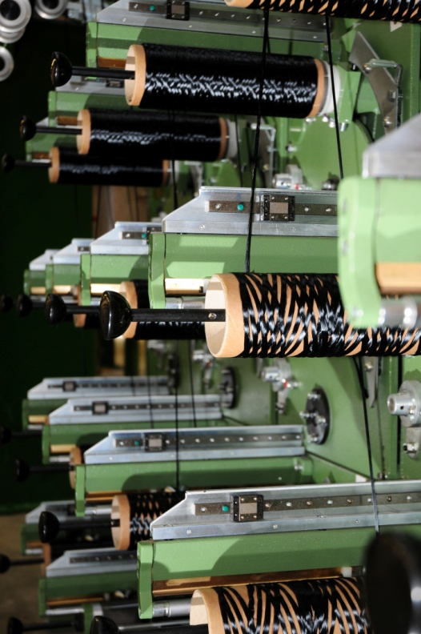
Efficiency Advances – Within Reach
Don’t Try to Reinvent the Process – Optimize Existing Unit Operations
Minimize the Timeline for Technology Development and Deployment
Assess and Minimize Environmental Losses
  Improved Insulation Profiles
  Minimize Surface Area and Wall Losses
  Minimize Exhaust Losses

Slide 28
Rethinking Oxidation Oven Advancements
Use of Hot Make Up Air at Ovens – Recovered Energy from TOX
(Of Course)
Measurement of Atmospheric Concentration per Zone -- Allows for Higher Concentrations of Waste Gases within Oven and Reduction of Total Exhaust Flow From Oven – Can results in 50% or Greater Reduction in Exhaust Air From Oven
  Process Control Technique Exclusive to Harper International Oven Systems – Only Capable with Advanced Sealing
Measurement of Total Air Room Air Ingress at Slots through the use of Flow Meters to measure Exhaust and Makeup air (Room Air Ingress at Slots is a result by Difference)
  Process Control Technique Exclusive to Harper International Oven Systems

Slide 29
Oven Advancements
 |  | Traditional Line | Oven Improvements | Additional Insulation in Ovens | All Advancements, Combined
Capacity | TPY | 1500 | 1500 | 1500 | 1500
Operating Hours Per Year | Hrs | 7200 | 7200 | 7200 | 7200
Oven Operating Power |  | 3843.0 | 2682.6 | 3765.0 | 2604.6
Recirculation | kW-hr | 969.0 | 872.1 | 969.0 | 872.1
Exhaust | kW-hr | 2127.0 | 1063.5 | 2127.0 | 1063.5
Wall Losses | kW-hr | 494.0 | 494.0 | 416.0 | 416.0
Sensible Heat of Fiber | kW-hr | 253.0 | 253.0 | 253.0 | 253.0

Slide 30
Viable LT / HT Furnace Advancements
Three Primary Advancements to Yield Energy Reduction (In Order of Increase Developmental Risk
  Increase Insulation in HT to Reduce Thermal Losses; Reduction of Cooling Water at HT; Reduction of Terminal Losses (Low / No Risk)
  Use of an Interconnect Chamber --between LT and HT Furnaces; reduces Losses and Reduced N2 Usage; Further Reduces Number of Vent Lines and Vent Line Losses; (Moderate Risk)
  Use of Fold Over Design to Reduce Wall (Roof to Floor) Losses between the LT and HT and / or allow power sharing from HT to LT (Equipment Development Risk – ‘Ergonomics’)

Slide 31
Rethinking LT HT Furnace Power Utilization
LT Furnace HT Furnace
Effectively, Furnaces are Leaky Boxes Losing Energy Through:
      Wall Losses (Controlled by Insulation Profile)
      Slot Losses (Controlled by Purge Chamber Design)
      Exhaust Losses (Carried Away with Gases)

Slide 32
Rethinking LT HT Furnace Power Utilization
LT Furnace
HT Furnace
Elimination of
Surface Area
Total Surface Area = (X m2)
Reduced Surface Area ~ (70%X m2)
With reduction of Purge Chambers Losses
HT Furnace
LT Furnace

Slide 33
LT / HT Furnace Advancements
LT Furnace | Slot Width | mm | 300 | 1750 | 3000
 | Shell Width | mm | 700 | 2150 | 3500
 | Shell Length | mm | 4465 | 9700 | 15200
 | Shell Height | mm | 1160 | 1370 | 1420
HT Furnace | Slot Width | mm | 300 | 1750 | 3000
 | Shell Width | mm | 700 | 2150 | 3500
 | Shell Length | mm | 4465 | 9700 | 15200
 | Shell Height | mm | 1220 | 1370 | 1520
Surface Area LT |  | m2 | 18.2 | 74.2 | 159.5
Surface Area HT |  | m2 | 18.9 | 74.2 | 163.2
Total Surface Area |  | m2 | 37.1 | 148.4 | 322.8
Combined Unit Surface Area |  | m2 | 30.8 | 106.6 | 216.3
Percent Reduction from Traditional Design Surface Area |  | % | 83.1% | 71.9% | 67.0%

Slide 34
LT / HT Furnace Advancements
 |  | Traditional Line | Additional Insulation in HT | Combination Furnace Design | Furnace Purge Chamber | All Advancements, Combined
Capacity | TPY | 1500 | 1500 | 1500 | 1500 | 1500
Operating Hours Per Year | Hrs | 7200 | 7200 | 7200 | 7200 | 7200
LT Operating Power |  | 123.0 | 123.0 | 114.1 | 117.4 | 108.5
Wall Losses | kW-hr | 27.0 | 27.0 | 18.1 | 27.0 | 18.1
Exhaust | kW-hr | 16.0 | 16.0 | 16.0 | 10.4 | 10.4
Sensible Heat of Fiber | kW-hr | 80.0 | 80.0 | 80.0 | 80.0 | 80.0
HT Operating Power |  | 626.2 | 243.6 | 566.5 | 579.6 | 505.1
Wall Losses | kW-hr | 267.6 | 243.6 | 207.9 | 267.6 | 193.1
Exhaust | kW-hr | 103.6 |  | 103.6 | 57.0 | 57.0
Element / Terminal Losses | kW-hr | 93.0 |  | 93.0 | 93.0 | 93.0
Cooling Water Losses | kW-hr | 0.0 |  | 0.0 | 0.0 | 0.0
Sensible Heat of Fiber | kW-hr | 162.0 |  | 162.0 | 162.0 | 162.0

Slide 35
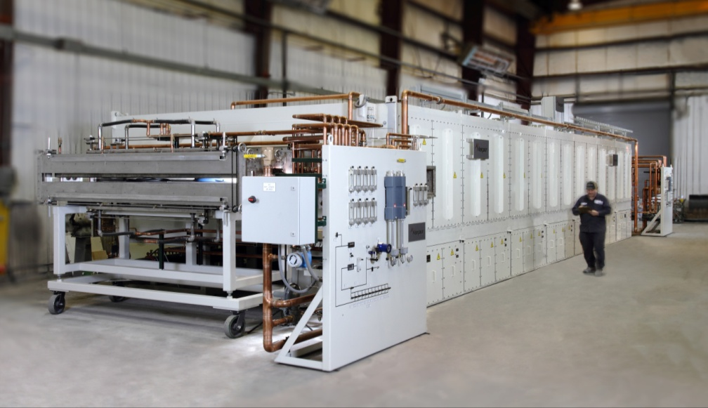
Peripheral Benefits to Waste Gas Abatement
Possibility of >50% Reduction in Size of Waste Gas Abatement Unit due to reduction of Oven Exhaust (>50% Reduction in Exhaust Air From Oven)
Reduction in Total Exhaust Flow from LT / HT Furnaces(s) due to advancements in Carbonization: Lower Line Losses, Fewer Vent Lines

Slide 36
Achievable Targets for the Future

Slide 37
Achieving Future Improvements:
Ovens
Evaluation Based On 1500 TPY Capacity - 3000mm Design | Priority | Impact kW-hr Saved | Investment Additions | Investment Reductions | Risks
Oven Insulation Thickness | 2 | 78.0 | Additional Insulation Costs | - | Low to No Risk
Oven Exhaust Control and Reduction | 1 | 1360.4 | Flow Controls at Oven, Atmosphere Monitoring | Smaller Exhaust Fans, Smaller, Waste Gas Abatement Unit, Smaller Waste Gas Abatement Exhaust Fans | Oven Sealing, Air Distribution and Process Control are Critical

Slide 38
Achieving Future Improvements
LT Furnace
Evaluation Based On 1500 TPY Capacity - 3000mm Design | Priority | Impact kW-hr Saved | Investment Additions | Investment Reductions | Risks
Reduce Wall Loss - LT and HT Combination | 3 | 68.6 Total | Investment Cost to Redesign Furnaces for Maintenance Access | - | Maintenance Access to Muffle must be Engineered.
Sealed LT and HT interconnect Chamber | 4 | 52.2 Total | Investment and Development for Sealed Chamber, Investment and Development of Enclosed Drive Stand. R&D to determine impact of Intermediate Drive Operating Experience | Reduced Nitrogen Consumptions, Reduced Exhaust / Vent Infrastructure, Reduced Waste Gas Abatement | Risk of Enclosed Drive Stand and Operator Access.

Slide 39
Achieving Future Improvements:
HT Furnace
Evaluation Based On 1500 TPY Capacity - 3000mm Design | Priority | Impact kW-hr Saved | Investment Additions | Investment Reductions | Risks
HT Wall Loss Reduction - Insulation Profile | 5 | 24.0 | Additional Insulation Costs | - | Low to No Risk. Existing Designs
Reduce Wall Loss - LT and HT Combination | 3 | 68.6 Total | Investment Cost to Redesign Furnaces for Maintenance Access | - | Maintenance Access to Muffle must be Engineered.

Slide 40
The Near Future Targets
 |  | Traditional Line | Oven Improvements | Additional Insulation in Ovens and HT | Combination Furnace Design | Furnace Purge Chamber | All Advancements, Combined
Capacity | TPY | 1500 | 1500 | 1500 | 1500 | 1500 | 1500
Operating Hours Per Year | Hrs | 7200 | 7200 | 7200 | 7200 | 7200 | 7200
Oven Operating Power |  | 3843.0 | 2682.6 | 3765.0 | 3843.0 | 3843.0 | 2604.6
LT Operating Power |  | 123.0 | 123.0 | 123.0 | 114.1 | 117.4 | 108.5
HT Operating Power |  | 626.2 | 626.2 | 606.2 | 566.5 | 579.6 | 505.1
Balance of Unit Operations | kW-hr | 1282.9 | 1082.9 | 1282.9 | 1282.9 | 1282.9 | 1082.9
Estimated Total | kW-hr | 5875.1 | 4514.7 | 5414.5 | 5806.5 | 5822.9 | 4301.1
Specific Power Consumption | kW-hr / kg CF | 28.2 | 21.7 | 26.0 | 27.9 | 28.0 | 20.6
Operating Power Compared to Traditional Line | % |  | 76.8% | 92.2% | 98.8% | 99.1% | 73.2%
Cost of Electricity | USD / kW-hr | $0.05 | $0.05 | $0.05 | $0.05 | $0.05 | $0.05
Cost Per Year | USD / kW-hr | $2,115,050 | $1,625,306 | $1,949,234 | $2,090,339 | $2,096,250 | $1,548,402
Cost Savings Per Kilogram Produced | USD / kg CF |  | $0.33 | $0.11 | $0.02 | $0.01 | $0.38
Reduction over traditional Line | USD Per Year |  | $489,744 | $165,816 | $24,710 | $18,799 | $566,647

Slide 41

Thank you for your time!
Spark the future.™
Visit us at harperintl.com and harperbeacon.com

